Slide 1
Wi-Fi Penetration Testing
Presented by:
Md. Tauseef Alam
Anuj Saraswat
Saurav Shah
T. Kuki
Gaurav Narang
April 2016

Slide 2
Acknowledgement
The success and outcome of this project required a lot of guidance and assistance from many people and we are extremely fortunate to have got this all along the completion of our project work. Whatever we have done is only due to such guidance and assistance and we would not forget to thank them.
We respect and thank Ms. Shikha Verma, for giving us an opportunity to do the project work in ‘WIFI-PENETRATION TESTING’ and providing us all support and guidance which made us complete the project on time. We are extremely grateful to her for providing such a nice support and guidance though she had a busy schedule managing her departmental routines.
We owe our profound gratitude to all those who were involved in this project directly or indirectly through their timely support. We are thankful to and fortunate enough to each other in our group, who took keen interest in our project work and guided each other all along, till the completion of the project work by providing all the necessary information for developing a good system.

Slide 3
Certificate
This is to certify that the project entitled, “WIFI-PENETRATION TESTING” submitted by the following students Md. Tauseef Alam, Anuj Saraswat ,Saurav Shah ,Thongminlien Kuki & Gaurav Narang under the guidance of Ms Shikha Verma in partial fulfillment of the requirements for the award of “B.Sc.(H) Comp. IV SEM” in “SOFTWARE ENGINEERING” at “RAM LAL ANAND COLLEGE” is an authentic work carried out under my supervision and guidance.
To the best of my knowledge, the matter embodied in the project has not been submitted to any other university/ institute for the award of any Degree or Diploma.
Date: 11/04/2016 Ms.Shikha Verma
Assistant Professor
Dept. of Computer Science
Ram Lal Anand

Slide 4
Contents
Introduction
Software Development Methodology
* Process Model
3. Software Requirement Specification (SRS)
* Introduction
* Purpose
* Scope
* S/W and H/W requirements
Design Specification
* Data Flow Diagrams
* ER Diagram
* Data Dictionary
Project Management
6. Risk Management
7. Timeline Chart
8. Code Development
* Sample Code
9. Testing
10. Limitations
11. Future Scope
12. Conclusion
11. Refrences

Slide 5

INTRODUCTION What is a Penetration Testing?
A penetration test is a method of evaluating the security of a computer system or network by simulating an attack from a malicious source, known as a Black Hat Hacker, or Cracker. – Wikipedia
A penetration test is an attack on a computer system, network or Web application to find vulnerabilities that an attacker could exploit with the intention of finding security weaknesses, potentially gaining access to it, its functionality and data.
Pen tests can be automated with software applications or they can be performed manually.

Slide 6
Why Bother?
Active pen-testing teaches you things that security planning will not
What are the vulnerability scanners missing?
Helps identify weakness that may be leveraged by insider threat or accidental exposure
Raises security awareness
I better not leave my terminal unlocked because I know that those security guys are lurking around somewhere.
If I can break into it, so could someone else!

Slide 7

Scope of Penetration Testing
Social Engineering
Hi Help Desk…I’m Mr. Jones…Can you tell me what my password is?
Physical facilities audit
Hmm, I forgot my badge... but there's 200 yards of fence missing on the east side of the center
Wireless War Driving
Detection of rogue or weakly encrypted AP’s.
Dumpster Diving
How much fun can I have in the dumpster…whoops…I’ve found someone’s Tax forms with SSN.

Slide 8
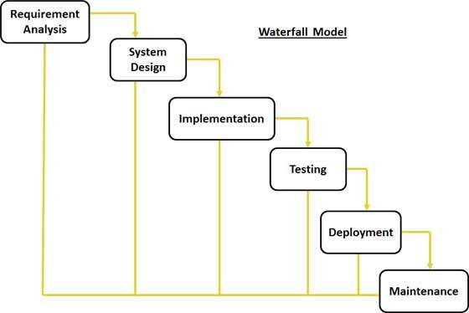
Process Model:

Slide 9
Software Requirement Specification
INTRODUCTION: Pen-testing is the process to identify security vulnerabilities in an application by evaluating the system or network with various malicious techniques. A penetration testing is a method of evaluating the security of a computer system.
PURPOSE : Purpose of this test is to secure important data from outsiders like hackers who can have unauthorized access to system.
SCOPE : To secure user data and to find security vulnerabilities in an access point
DEFINITIONS :
Packet – an amount of data transferred in a network.
Frame – a container which the packet is transferred within
Frames: Simply Data Packet typically made up of
Header,
Payload,
Integrity Check (CRC)

Slide 10
Software Requirement Specification
Frame Header:
Source and Destination
Ether Type (What Protocol)
ACRONYMS & ABBREVIATIONS :
AP : Access Point
BSSID : Basic Service Set Identifier
ESSID : Extended Service set Identifier
WEP : Wired Equivalent Privacy
WPA : Wireless Protected Access
WPS : Wi-Fi Protected Setup
PMK : Pairwise Master Key
PTK : Pairwise Transient Key
SYN : Synchronization
MIC : Message Integrity Code
IV : Initialization Vector
ARP : Address Resolution Protocol
IP : Internet Protocol

Slide 11
Software Requirement Specification
Product Perspective : To test the security of AP
Product Function : Pen-testing
CONSTRAINTS:
Targets > 0
DEAUTH_TIMEOUT = 10 sec
ATTACK_MIN_POWER > 0 dBm
WEP_ATTACK_TIMEOUT = 600 sec
WEP_CRACK_AT_IVS = 10,000
WPA_ATTACK_TIMEOUT = 500 sec
WPS_ATTACK_TIMEOUT = 660 sec
H/W REQUIREMENTS : Wireless Adapter Capable of Packet Injection.
S/W REQUIREMENTS
1)Linux OS 2)Aircrack-ng suite 3)Wireshark / Tshark/Pyrit/Cowpatty 4)Reaver/Wash

Slide 12




Requirement Specifications:
Wireshark
Kali Linux
Cowpatty
Aircrack Suite

Slide 13
Data Flow Diagram
Level 0
Wi-Fi Pen Testing
Users
Technicians
Level 1
Wi-Fi Pen Testing
User
Technician
Vulnerability Check
Encryption Check
Types of Attack
Result

Slide 14
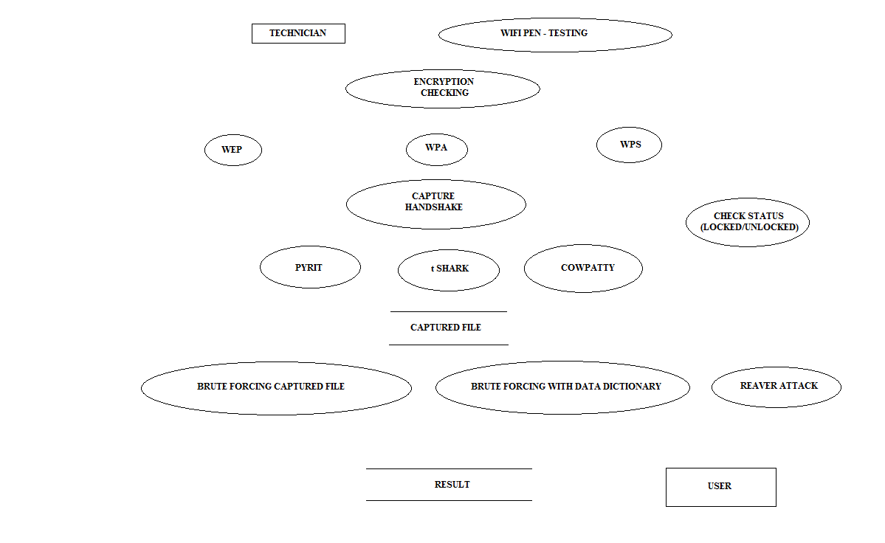
DFD LEVEL-2

Slide 15
ER Diagram
ESSID
Channel
Clients
Password
User/AP
BSSID
Exploring Vulnerability
WPS Pin
Power
Technician/Pen-tester

Slide 16
Data Dictionary
Attribute Name | Required | Type | Field Length
BSSID | Yes | Hex | Bits
ESSID | Yes | Text | 64 Bytes
Power | Yes | dB or watt | 0.5 watt
WPS Pin | Yes | Number | 8 Digits
Password | Yes | Alpha-numeric | -
Channel | Yes | Number | 1-14 (1-11 in US)
Clients | - | - | 253

Slide 17
WPS Pin Calculation
BUILD OUT OF 8 DIGITS.
FIRST FOUR ARE IMMEDIATELY CHECKED.
LAST DIGIT IS CHECK SUM.
ORIGINAL COMBINATIONS SHOULD BE:
10^8(100 MILLION)
AFTER CONSIDERING 4 DIGIT CHECK:
10^4+10^4=20,000
AFTER CHECKSUM DIGIT:
10^4+10^3=11,000

Slide 18
Handshake Performed
Station
AP
ANonce
Station constructs the PTK
SNonce + MIC
AP constructs the PTK
GTK + MIC
ACK
Four Way Handshake

Slide 19
WEP Attacks
-p 0841 :
*This attack allows to choose a specific packet for replaying
(injecting). The attack can obtain packets to replay from two
sources. The first being a live flow of packets from the wire‐
less card. The second being from a pcap file. Reading from a
file is an often overlooked feature of aireplay-ng. This allows
us to read packets from other capture sessions or quite often,
various attacks generate pcap files for easy reuse. A common use
of reading a file containing a packet your created with packet‐
forge-ng.
Sets the Frame Control Field such that the packet looks like it is being sent from a wireless client to the access point.
Usage: aireplay-ng -2 <filter options> <replay options> -r <file name> <replay-interface>

Slide 20
WEP Attacks
ARP Request Replay Attack:
* The classic ARP request replay attack is the most effective way
to generate new initialization vectors (IVs), and works very
reliably. The program listens for an ARP packet then retransmits
it back to the access point. This, in turn, causes the access
point to repeat the ARP packet with a new IV. The program
retransmits the same ARP packet over and over. However, each ARP
packet repeated by the access point has a new IVs. It is all
these new IVs which allow you to determine the WEP key.
Most effective way to generate new initialization vectors (IVs).
The program listens for an ARP packet then retransmits it back to the access point.
Usage: aireplay-ng -3 -b 00:13:--:--:--:-- -h 00:--:--:--:--:--mon0

Slide 21
WEP Attacks
Chop-Chop Attack:
* This attack, when successful, can decrypt a WEP data packet
without knowing the key. It can even work against dynamic WEP.
This attack does not recover the WEP key itself, but merely
reveals the plaintext. However, some access points are not vul‐
nerable to this attack. Some may seem vulnerable at first but
actually drop data packets shorter that 60 bytes. If the access
point drops packets shorter than 42 bytes, aireplay tries to
guess the rest of the missing data, as far as the headers are
predictable. If an IP packet is captured, it additionally checks
if the checksum of the header is correct after guessing the
missing parts of it. This attack requires at least one WEP data
packet.
Can decrypt a WEP data packet without knowing the key.
Requires at least one WEP data packet.
Usage: aireplay-ng -4 -h 00:09:--:--:--:-- -b 00:14:--:--:--:--mon0

Slide 22
WEP Attacks
Fragmentation Attack:
* This attack, when successful, can obtain 1500 bytes of PRGA
(pseudo random generation algorithm). This attack does not
recover the WEP key itself, but merely obtains the PRGA. The
PRGA can then be used to generate packets with packetforge-ng
which are in turn used for various injection attacks. It
requires at least one data packet to be received from the access
point in order to initiate the attack.
This attack does not recover the WEP key itself, but merely obtains the PRGA(pseudo random generation algorithm).
The PRGA can then be used to generate packets with packetforge-ng which are in turn used for various injection attacks.
Usage: aireplay-ng -5 -b 00:14:--:--:--:-- -h 00:AB:--:--:--:-- mon0

Slide 23
WEP Attacks
Caffe-Latte Attack:
* In general, for an attack to work, the attacker has to be in the
range of an AP and a connected client (fake or real). Caffe
Latte attacks allows one to gather enough packets to crack a WEP
key without the need of an AP, it just need a client to be in
range.
Allows you to obtain a WEP key from a client system.
Capturing an ARP packet from the client, manipulating it and then send it back to the client. The client in turn generates packets which can be captured by airodump-ng.
Usage: aireplay-ng -6 -h 00:09:--:--:--:-- -b 00:13:--:--:--:-- -D mon0

Slide 24
WEP Attacks
Hirte Attack:
* This attack turns IP or ARP packets from a client into ARP
request against the client. This attack works especially well
against ad-hoc networks. As well it can be used against softAP
clients and normal AP clients.
Client attack which can use any IP or ARP packet.
Capturing an ARP packet from the client, manipulating it and then send it back to the client. The client in turn generates packets which can be captured by airodump-ng.
aireplay-ng -7 -h 00:09:--:--:--:-- -D mon0

Slide 25
Project Management
Project management involves the planning, monitoring, and control of the people, process, and events that occur as software evolves from a preliminary concept to an operational implementation. Project managers plan, monitor, and control the work of a team of software engineers. Effective software project management focuses on the four P‟s: people, product, process, and project.
Function Point Calculation
Function-oriented software metrics use a measure of the functionality delivered b_{y} the application as a normalization value. Since, “functionality” cannot be measured directly; it must be derived indirectly using other direct measures. Function points are computed by completing the table . Five information domain characteristics are determined and counts are provided in the appropriate table location. Information domain values are defined in the following manner:
Number of user inputs: Each user input that provides distinct application oriented data to the software is counted. Inputs should be distinguished from inquiries, which are counted separately.
Number of user outputs: Each user output that provides application oriented information to the user is counted. In this context output refers to reports, screens, error messages, etc. Individual data items within a report are not counted separately.
Number of user inquiries: An inquiry is defined as an on-line input that results in the generation of some immediate software response in the form of an on-line output. Each distinct inquiry is counted.
Number of files: Each logical master file (i.e., a logical grouping of data that may be one part of a large database or a separate file) is counted.
Number of external interfaces: All machine readable interfaces (e.g., data files on storage media) that are used to transmit information to another system are counted.

Slide 26
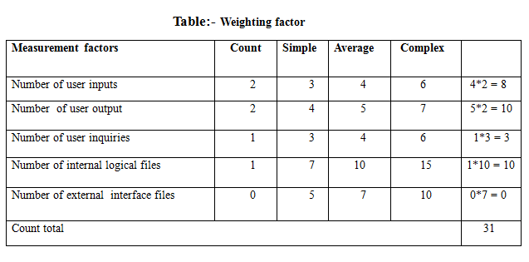
Project Management
For Avg. case

Slide 27
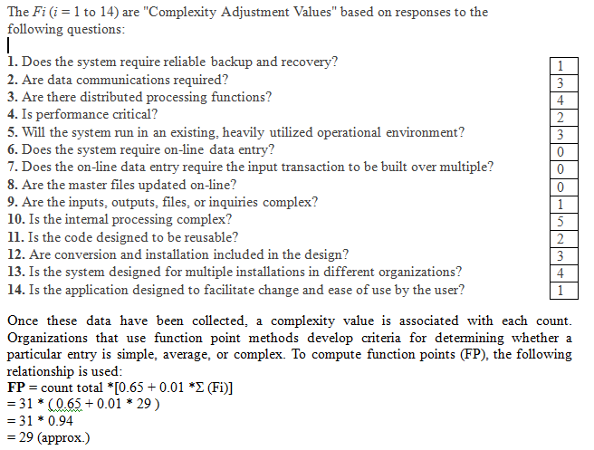
Project Management

Slide 28
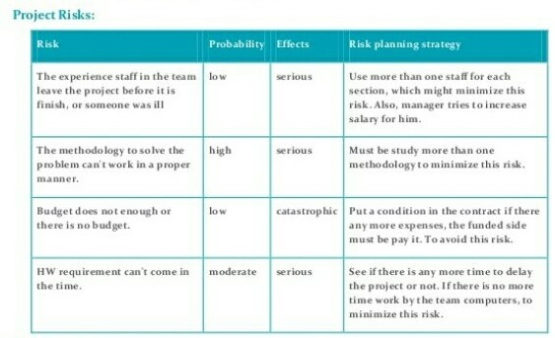
Risk Management
Risk Management deals the various risks involved in the software development. Risk can be related with time , budget etc.

Slide 29
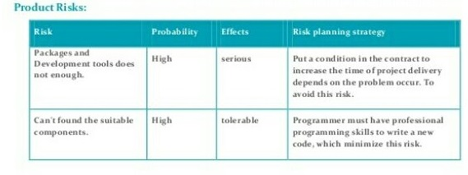
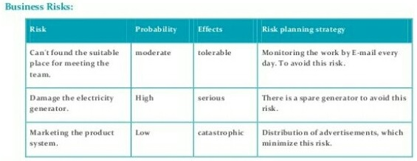
Risk Management

Slide 30
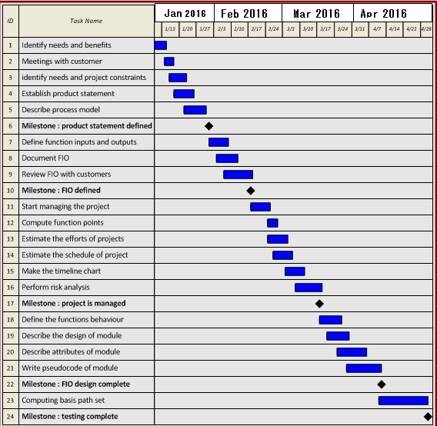
Timeline Chart

Slide 31
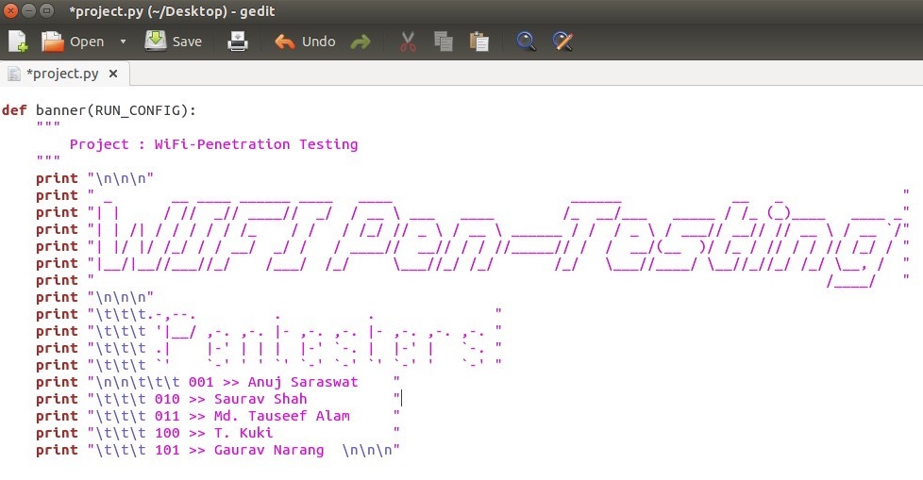
Code Development

Slide 32
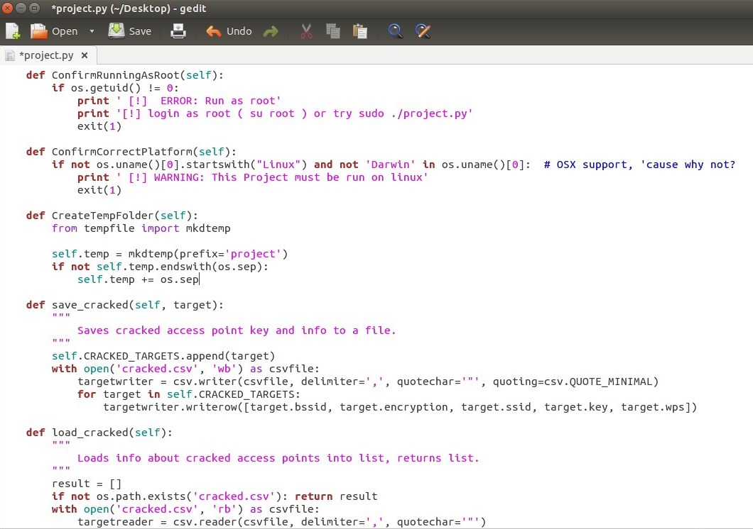
Code Development

Slide 33
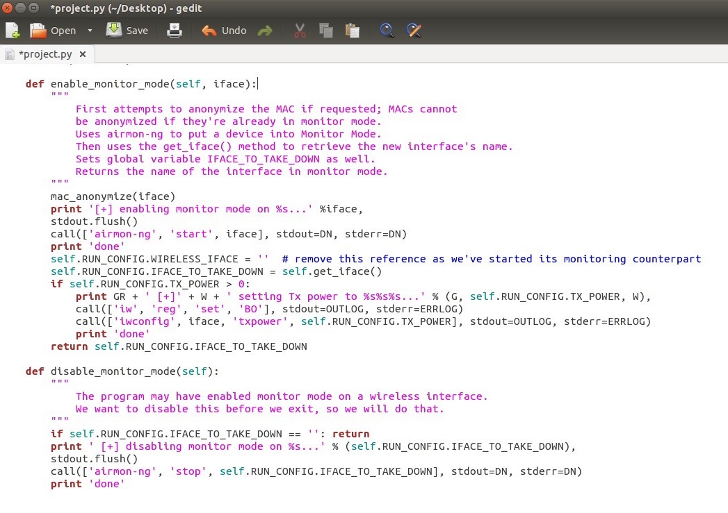
Code Development

Slide 34
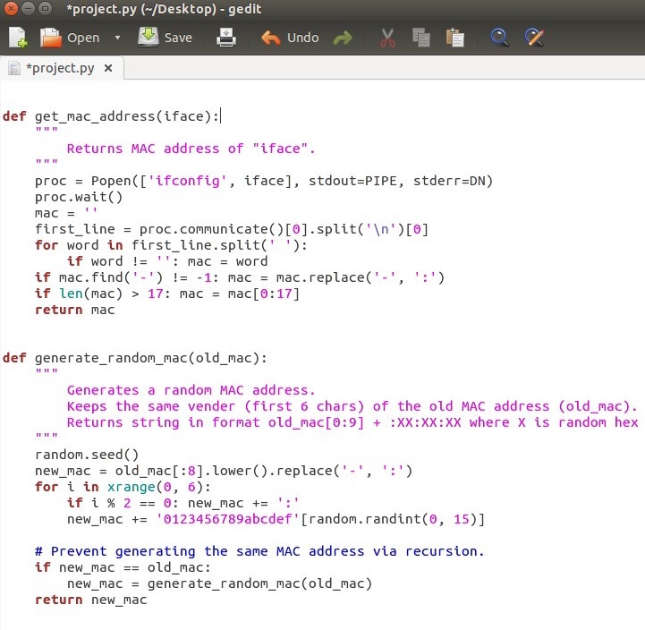
Code Development

Slide 35
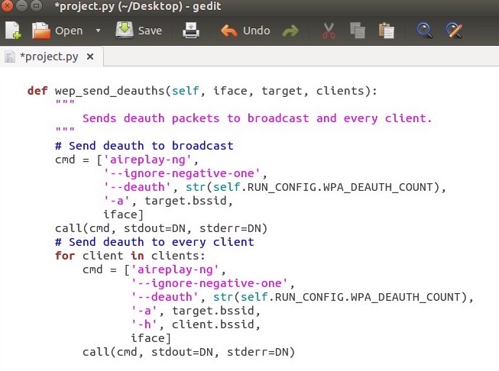
Code Development

Slide 36
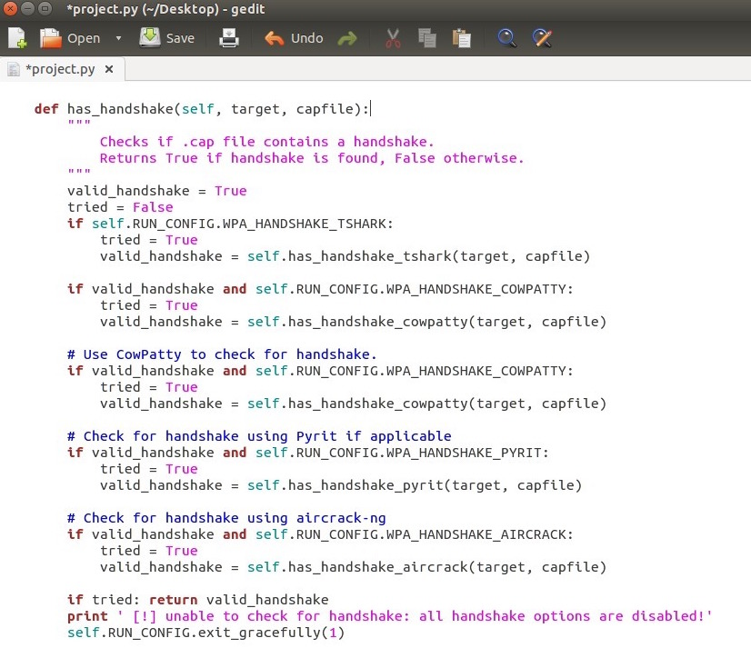
Code Development

Slide 37
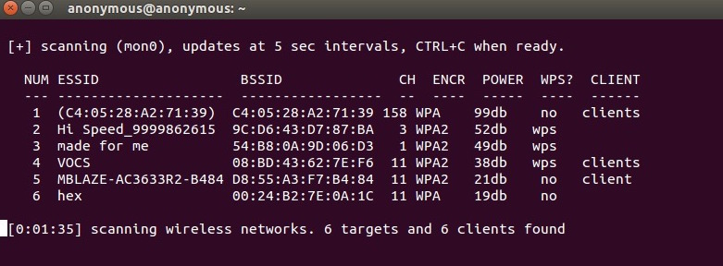
Software Testing

Slide 38
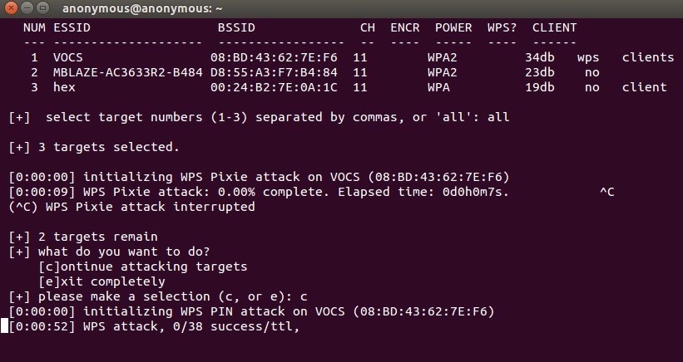
Software Testing

Slide 39
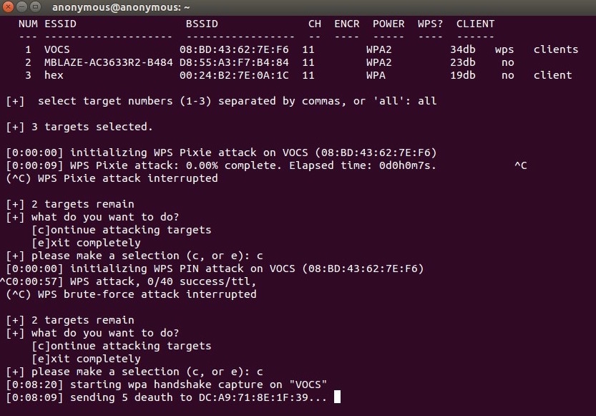
Software Testing

Slide 40
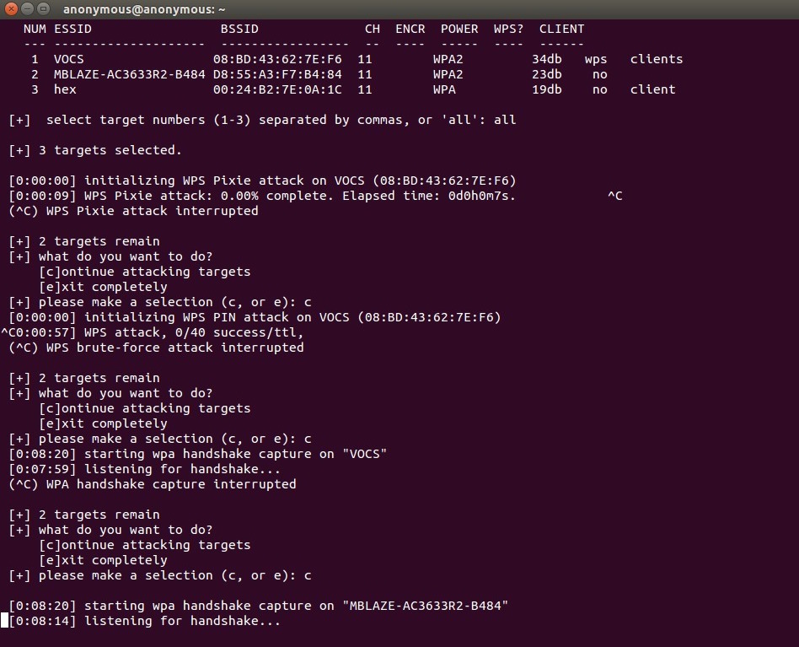
Software Testing

Slide 41
Limitations:
Network Strength
-The lesser the power of a AP, lesser the chances to penetrate in the system.
Channel Noise
-Router automatically switches between channels when it is densely populated and
thus make it less possible to penetrate.
MAC Address Filtering
-Limiting the number of users in an AP or restricting to the specific user may
intervene the work.
Hidden AP
-Hidden access point doesn’t easily allow to see in the system.
WPS Locked
-WPS pin disabled systems are less vulnerable.

Slide 42

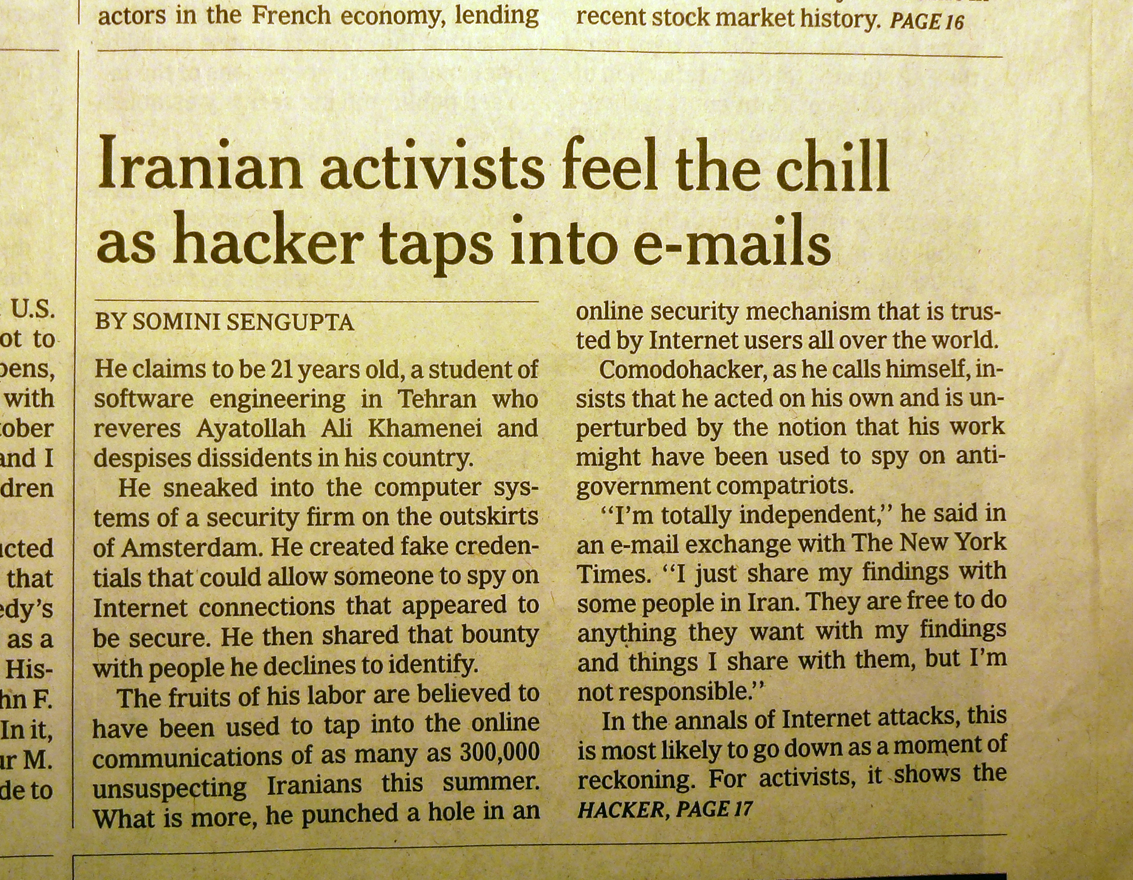
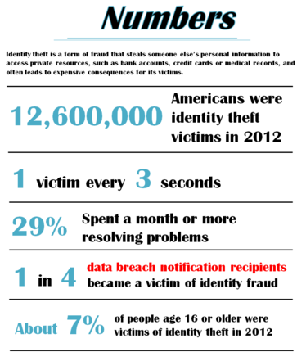

Future Scope

Slide 43


Future Scope
Batman won’t be forever.
Deadpool has arrived.
The security measures need to be checked as Technology is advancing every second. Someone must be vigilant. Personal information must be kept safe in this digital world. Encryption techniques shall grow stronger, so will the attempt to get into it. Then, going to bed peacefully will only be possible if these testing are done and made sure data is safe from hackers.

Slide 44
Conclusion
Penetration testing is a comprehensive method to identify the vulnerabilities in a system. It offers benefits such as prevention of financial loss; compliance to industry regulators, customers and shareholders; preserving corporate image; proactive elimination of identified risks.
The testers can choose from black box, white box, and gray box testing depending on the amount of information available to the user. The testers can also choose from internal and external testing, depending on the specific objectives to be achieved.
The test phase is done in three steps: Information gathering, Vulnerability analysis, and Vulnerability exploit. This phase can be done manually or using automated tools.

Slide 45
References:
Images from Google search
https://en.wikipedia.org/
http://www.aircrack-ng.org/
https://www.kali.org/

